Slide 1
E-Mart
The Complete Grocery Store.!

Slide 2
Abstract
E-mart is A medium to connect seller and buyers.
The Main objective - To develop general purpose e-commerce store where ANY product can be brought from the comfort of home.
E-mart reduce time, effort, and expense of consumer.
E-mart is A platform for the seller.
For the entrepreneur, E-Mart generates new business opportunities i.e. A wider scope of consumer.

Slide 3
Modules
Admin:-
Log In
Manage Buyer
Manage Seller
Add / Remove Products

Slide 4
Modules
Buyer:-
Register
Log IN
View Products
Add to Cart
Place Order

Slide 5
Modules
Seller:-
Log In
Sell Products
Update Order Status

Slide 6
Specification
Front End:-
PHP (5.6.8)
HTML5
CSS3
JavaScript
Bootstrap
Back End:-
MySQL 5.5.32
Other Tools:-
XAMPP Software Package (3.2.1)
Adobe Dreamweaver CC 2015

Slide 7
Problem Identification
Not variety of products available.
Inconvenience at the time of delivery.
No home delivery, COD for food products.
Difficulty in buying & comparing products.
Seller have a limited scope of geographical area.

Slide 8
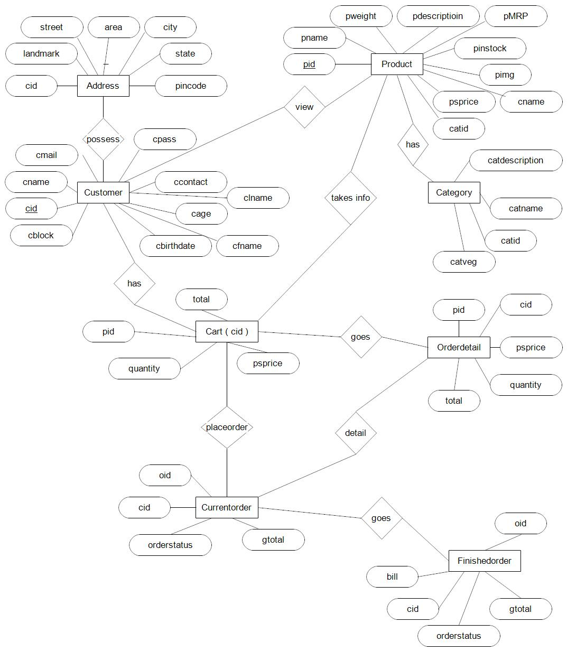
ER Diagram

Slide 9
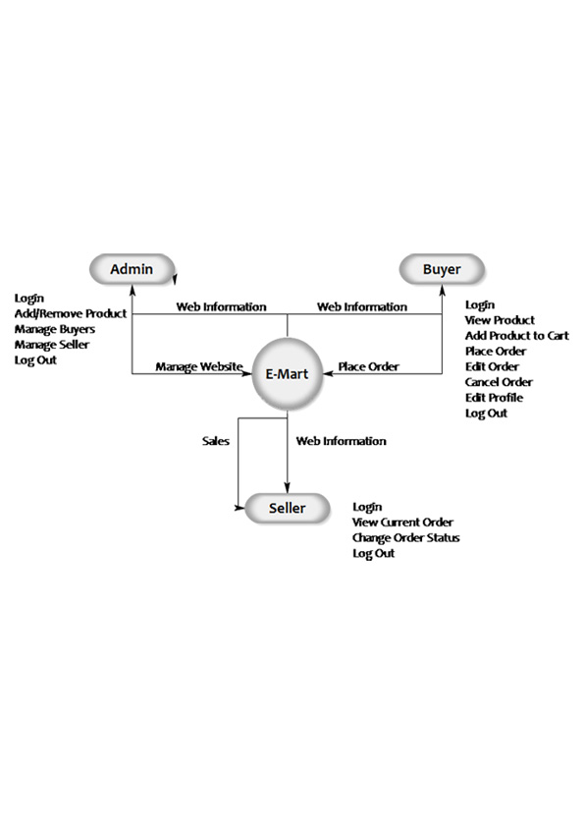
Data Flow Diagram

Slide 10
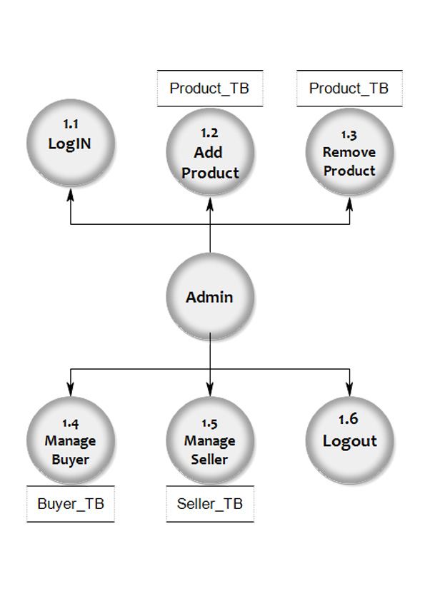
Data Flow Diagram

Slide 11
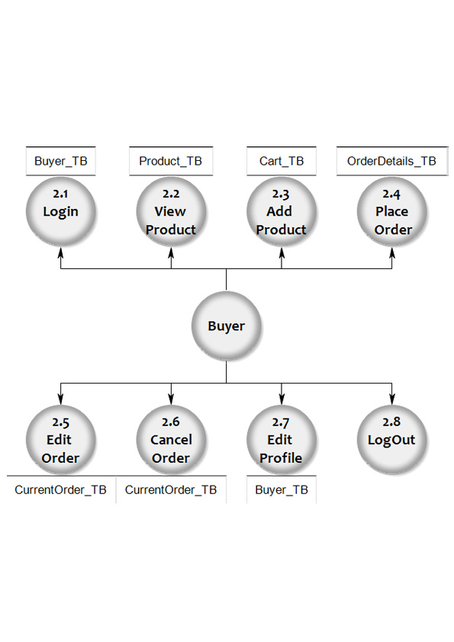
Data Flow Diagram

Slide 12
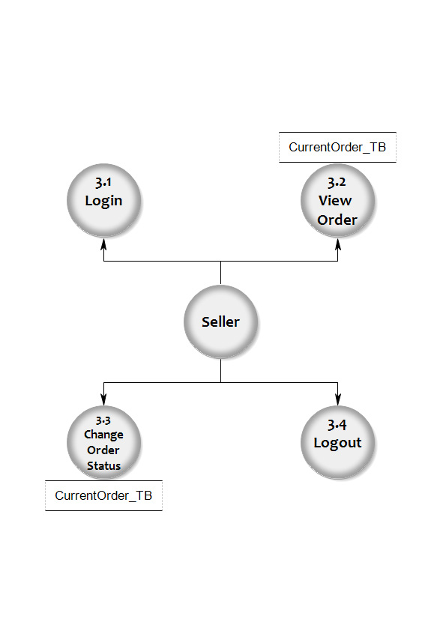
Data Flow Diagram

Slide 13
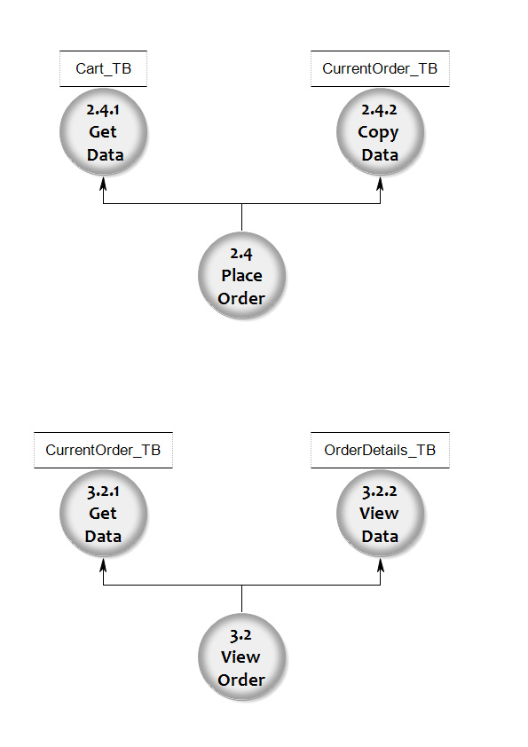
Data Flow Diagram

Slide 14
Screen Shots

Slide 15
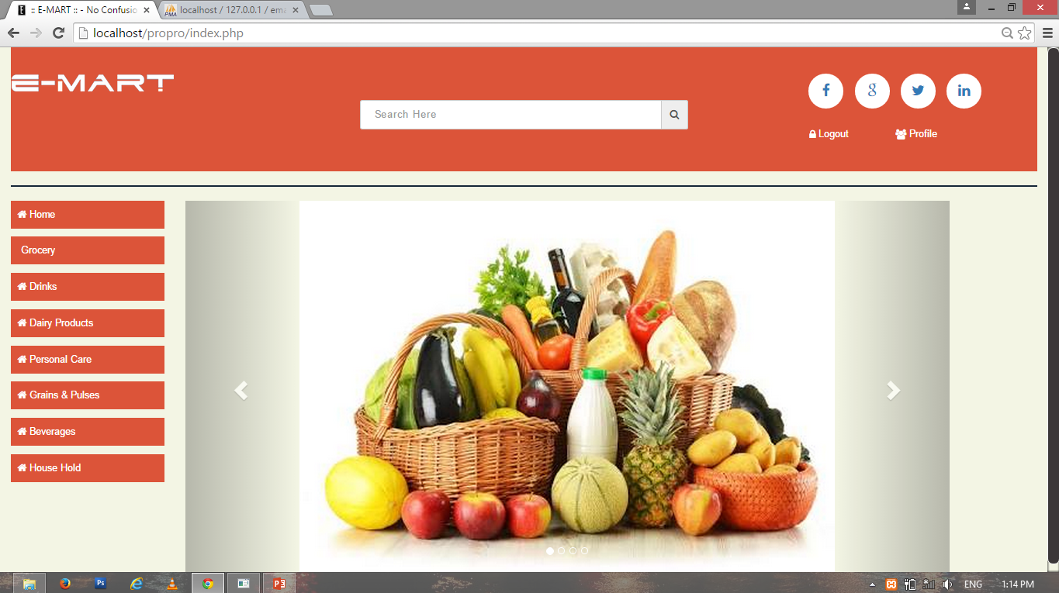

Slide 16
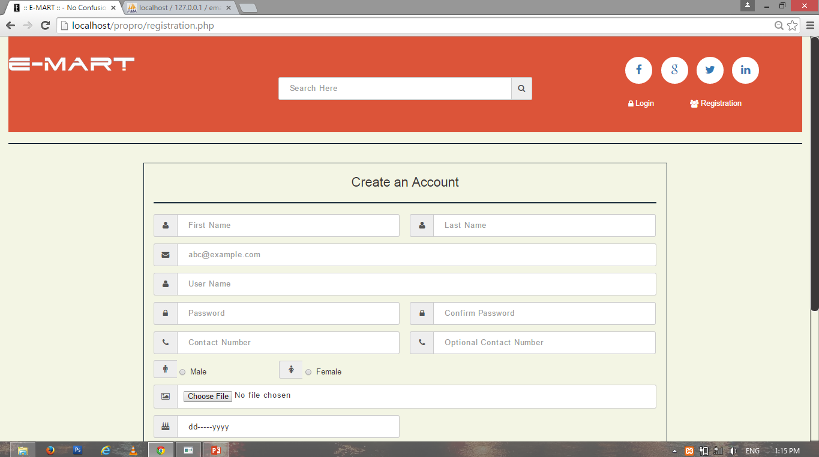

Slide 17
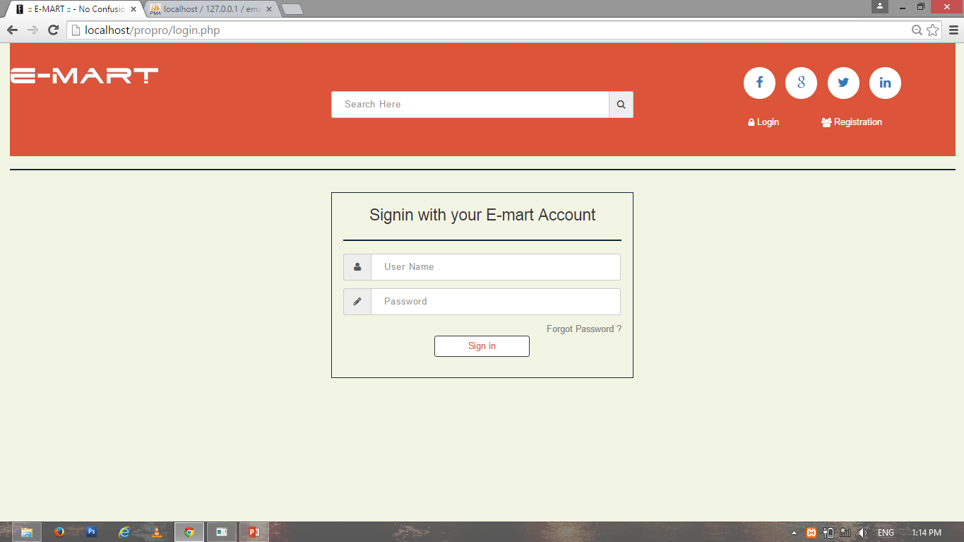

Slide 18
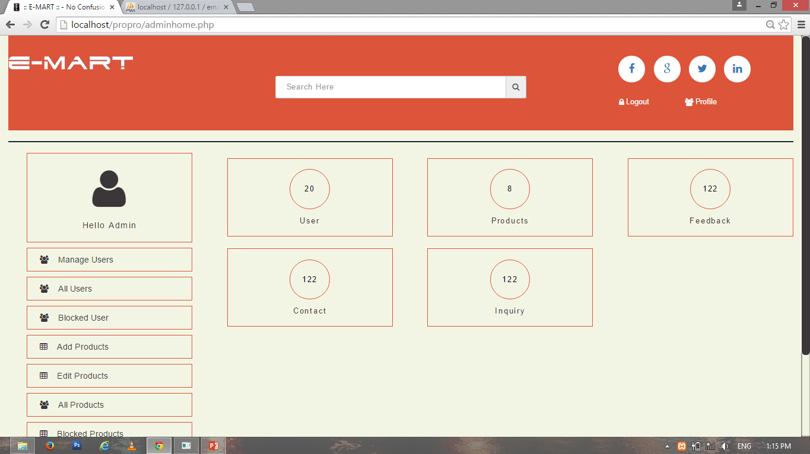

Slide 19
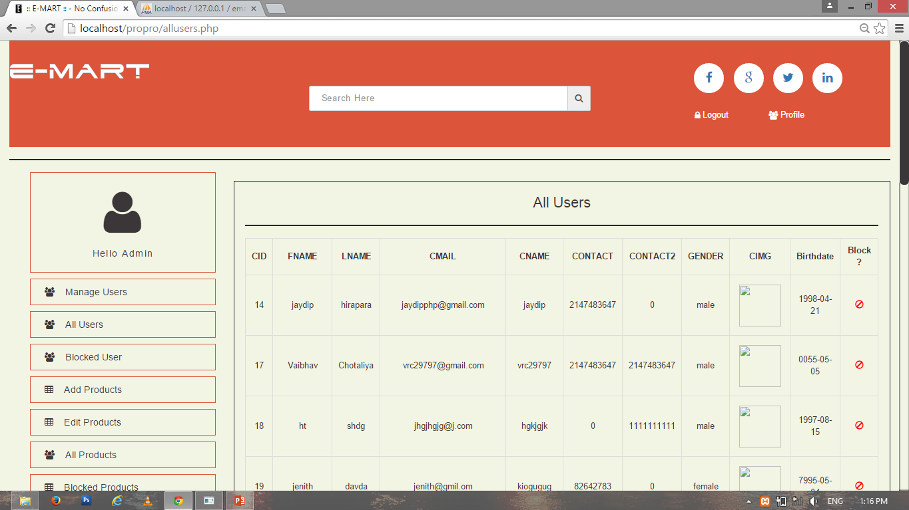

Slide 20
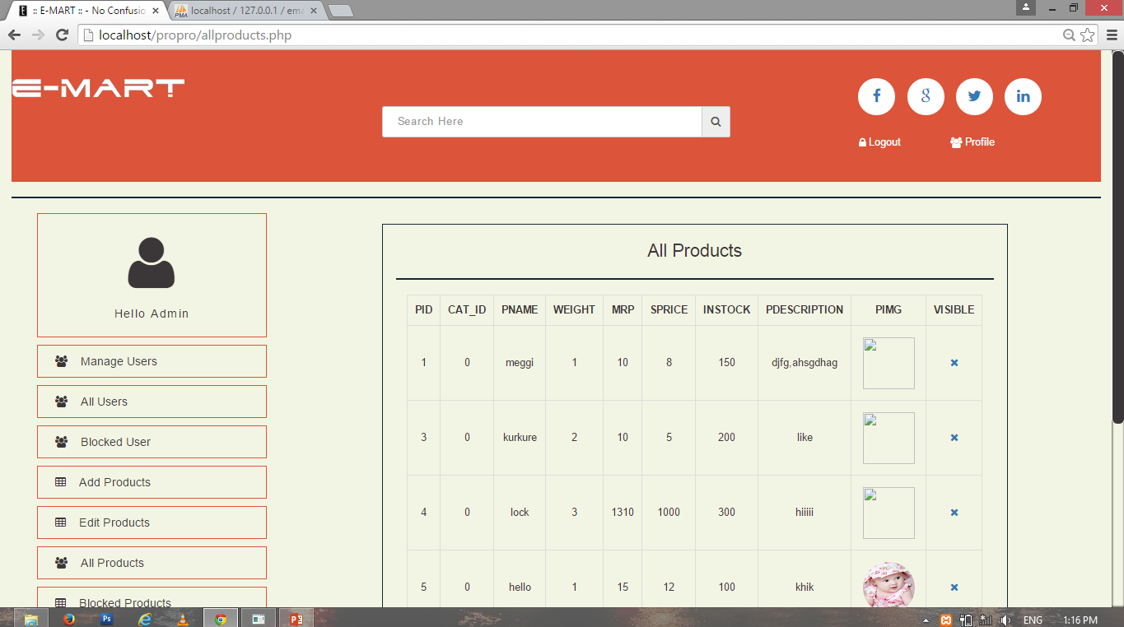

Slide 21
Expected Outcomes
Home Delivery and Cash on delivery.
Delivery at their preferred time.
Variety of products.
Comparison of Products.
Low cost Products.

Slide 22
Detailed Summary
Problem Solving Techniques:-
Bottoms-up approach.
Project life cycle model:-
Incremental.

Slide 23
Detailed Summary
The name of the website is E-mart which is made purposely for buying grocery or any daily usable products Online.
Services
Description of all Product
Comparison of Product.
Order Products.
Deliver Products.

Slide 24
Detailed Summary
Buyer Sign-in
View Products
Compare Products.
Order Products.
Seller View Order.
Seller Change Order Status.

Slide 25
Conclusion
Advantages
Improvements in productivity.
Customer satisfaction and general overall productivity.
Wider scope of consumers that can be attained by the entrepreneur.
Easier way for customer to buy items and also can view reviews of the product and customer service.
Customer would now be able to view and get update on their favourite brands or products and special discount that apply and would be able to make purchase any time.
Customer will have direct access to the product information, company, promotion and much more.

Slide 26
Conclusion
Limitations
Geographical limitations.
Product information must be update at arbitrary interval.
Payment methods are limited.
Single Seller.

Slide 27
Conclusion
Future Scope:-
Widen the range of product sold.
Provide more payment methods.
Widen the geographical area.
Increase Number Of Sellers.

Slide 28
Bibliography:-
Books:-
PHP with MY SQL
PHP 5
Dynamic Web Programming using PHP
Websites:-
www.w3schools.com
www.tutorialspoint.com
www.getbootstrap.com

Slide 29
E-Mart
-Chotaliya Vaibhav R. (136120316011)
-Hirpara Jaydip V. (136120316014)
-Tarpara Dhruv B. (136120316061)

